Slide 1
Claims A-to-Z
Presented By:
Jay Payan – President of J.L. Payan & Associates, Inc.
Jeremy Weaks – Manager of Prophetstown Mutual
Linda Olson – Manager of Town and Country Mutual
Beth Wingerter – Underwriter of Randolph Mutual
Tony Schuering – Attorney at Brown Hay + Stephens LLP

Slide 2
Legal Jargon
The views, information, or opinions expressed herein, or during the associated presentation, are solely those of the presenters and do not necessarily represent those of the Illinois Association of Mutual Insurance Companies (“IAMIC”) or its employees.
The information contained herein may include copyrighted material owned by a third party, the use of which has not been specifically authorized by the copyright owner. Notwithstanding a copyright owner’s rights under the Copyright Act, Section 107 of the Copyright Act, 17 U.S.C. § 107, allows use of copyrighted material, for limited purposes, without requiring permission from the rights holders. Those purposes include education, criticism, comment, news reporting, teaching, scholarship, and research. These so-called “fair uses” are permitted even if the use of the work would otherwise be infringing. If you believe that any content in this presentation violates your intellectual property or other rights, please notify us by email at leadership@iamic.org.
The material and information contained in this presentation is for general information purposes only. You should not rely upon the material or information in this presentation as a basis for making any decisions, of any kind, for any reason. To the fullest extent permitted by applicable law, IAMIC expressly disclaims all warranties, express or implied, and makes no representations or warranties of any kind, express or implied, about the completeness, accuracy, reliability, sufficiency, or suitability of the information contained herein or in the associated presentation. Any reliance you place on such material is strictly at your own risk.
IAMIC cannot and does not provide legal advice. Any reference to any source of legal authority of any kind contained herein, as well as any reference thereto in the associated presentation, is provided for general information and educational purposes only and is not a substitute for obtaining professional legal advice. Neither the information contained herein, nor the information disseminated during the associated presentation, should be considered as a source of authority with respect to any legal, operational, or governance issue. If you have any specific questions about the applicability of any legal authority applies to your specific circumstances, you should obtain and consult competent legal counsel.

Slide 3
Presentation setup
This process is for Non-Cat related type claims. Along the lines of 30k Fire or Wind isolated event
www.iamic.org – Place to find items discussed if you need samples or ideas where to start (Sign in then Members>Mutual Assistance Manual>Forms Quick Link & Click Claims)

Slide 4
Claim reported to Agent
Claim reported by Named Insured
  Power of Attorney (POA) may file, but may require POA documentation
  Some carriers do not accept claim submittal by contractor
  Trusts – Did the Trustee file, and can you obtain Certification or Affidavit
Claim may be reported by Public Adjuster representing the Insured
  Should require a copy of the valid Public Adjuster Contract signed by ALL Named Insureds
    See Illinois Department of Insurance guidelines for contract validity
  May elect to verify the claim report directly with the Named Insured

Slide 5

Verify Policy in Force
Named Insured
Loss Location
Date of Loss
  Specific Policy based on that Date
Identifying Potential Applicable Coverages
  Did changes impact the coverages available
Identifying potential Loss Payables

Slide 6

Claim Setup
Acknowledge claim receipt to Named Insured
    Preferably in writing, or email
    Should include reference to specific duties after loss
    Should reference claim contact person, or adjusting firm
Assign Adjuster
  In-House
    Staff Adjuster
    Desk Adjuster
  Monitoring & Management practices for staying current
  3rd Party
    Independent Adjuster Firm
    Catastrophe Program

Slide 7

Fact-Finding
Initial Contact to Insured
  Via telephone
  Gather initial / preliminary information
  Notify the Insured of duty to protect the property
  Are other policies or insurance in place with other Carriers
Schedule site inspection
  With Named Insured
  With Named Insured and Public Adjuster / Contractor
  Adjuster with notification to Insured prior on scheduling call

Slide 8
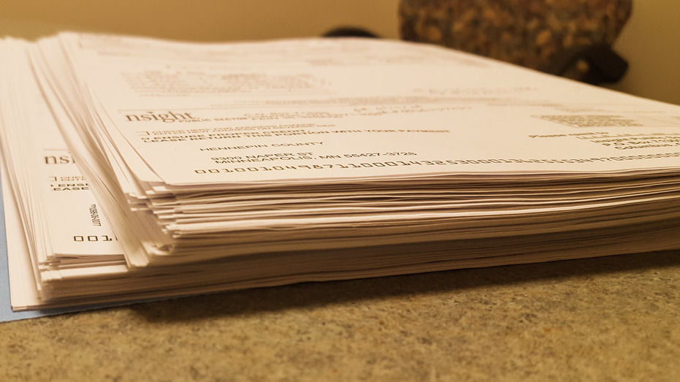
Documentation
Non-Waiver Agreement
  Best practice is to operate under a Non-Waiver on all claims
Inspection Photos
  Photos of direct physical damage
  Photos of mechanical / wear and tear damage
  PHOTOS OF NON-DAMAGED AREAS
Repair Estimates
  Written by Adjuster
  Submitted by Contractor
    Insured may need to be notified

Slide 9
NON-WAIVER AGREEMENT – (Sample)
IT IS HEREBY UNDERSTOOD AND AGREED by and between the parties signing this agreement, that any action taken by the hereinafter named Insurance Company or Companies in investigating the cause of loss, or investigating and ascertaining the amount of sound value, or the amount of loss and damage which occurred on or about _____________________, shall not waive or invalidate any of the terms or conditions of any policy or policies, and shall not waive or invalidate any rights whatever of either of the parties to this agreement.
IT IS FURTHER UNDERSTOOD AND AGREED that neither the examination of the insured or of any other person, the examination of the books of account, bills, invoices, or other vouchers of the insured or any other person, the request of any other information or the furnishing thereof or the incurring of any trouble or expense by the insured shall waive or invalidate any of the terms and conditions of the policy or policies, or any defense thereunder.
THE INTENT of this agreement is to preserve the rights of all parties hereto, and to permit an investigation of the cause of loss, the investigation and ascertainment of the amount of sound value, or the amount of loss and damage, or any of them without regard to the liability of the hereinafter named Insurance Company or Companies.
WITNESS our hand this ________day of ___________________________.
X__________________________ X___________________________
(Insured Signature) (Representative of Company)
___________________________ FOR________________________

Slide 10
Documentation – Power Consumption

Slide 11

Documentation Continued
Outside Expert Inspection
  Engineer
  Origin / Cause
  Plumbing Contractor
  Restoration Contractor
Recorded Statement
Examination Under Oath
Report from Law Enforcement
  Theft
  Vandalism / Malicious Mischief
  May be required per policy

Slide 12
Documentation Continued
Tax and Demolition Forms
  If required by Statute
    Farm Mutuals are exempt per Farm Mutual Act of 1986
    Farm Mutuals may elect to obtain regardless in an effort to be good partners to the local authorities
Status Letters to Insured
  Per 9.19 claims handling procedures
    Farm Mutuals are exempt per Farm Mutual Act of 1986
      Only Article 10, and Article 25 of the Insurance Code apply to Farm Mutuals
    Best practice would be in generally in line with 9.19 procedures, however not required for Farm Mutuals

Slide 13
Documentation Continued
Possible Written Communication Disclaimer
  Farm Mutual
  If you wish to take this matter up with the Illinois Department of Insurance, it maintains a consumer division in Chicago at 122 S. Michigan Avenue 19th Floor, Chicago, Illinois 60603, and in Springfield at 320 West Washington Street, Springfield, Illinois 62727-001.
  Domestic Mutual
  Rule 9.19 of Illinois Insurance Code requires that we advise you that if you wish to take this matter up with the Illinois Department of Insurance, it maintains a consumer division in Chicago at 122 S. Michigan Avenue, 19th Floor, Chicago, Illinois 60603, and in Springfield at 320 West Washington Street, Springfield, Illinois 62727-001.

Slide 14

Claim Review / Evaluation
Review claim facts
Coverage review per specific policy conditions
  Endorsements
  Restrictions
  Limitations
  Exclusions
Value of loss after coverage application
  May be less than Contractor estimate
  Or Insured Expectation
No Coverage / Denial Procedures

Slide 15
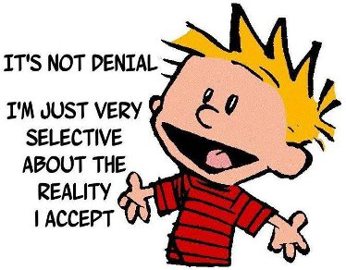
Claim Resolution
Denial Procedures
  Written
  Verbal?
  Both?
    Will depend on circumstances

Slide 16
Claim Resolution Continued
Claim Payment / Settlement
Signed Proof of Loss Required?
RCV vs. ACV
Retention Pending?
RCV Form Required?
Undisputed Payments
Compromise and Release

